Slide 1
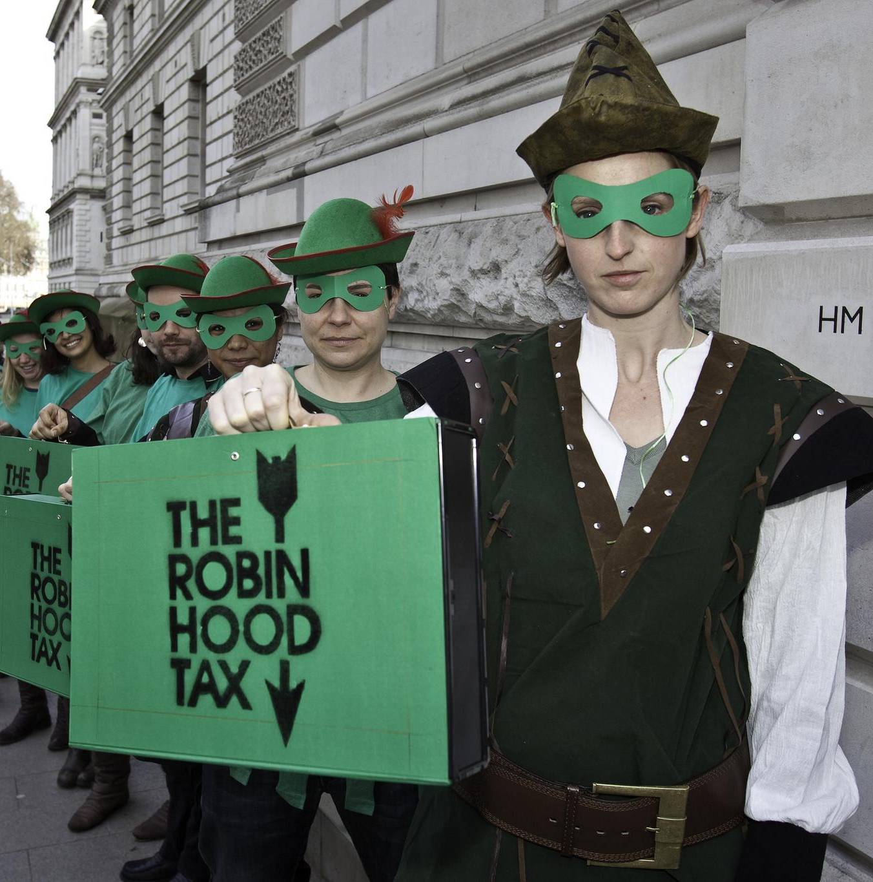
Robin
Hood
Tax
Campaign
and
UNISON
Tom Warren

Slide 2

How we got here
Launched in 2010
Calling for a small tax on transactions that financial sector players conduct between themselves and use the revenues to fund public services and the fight against poverty and climate change
They currently exist in different forms across 40 countries, including major financial capitals
The UK has a tax on shares that has existed for hundreds of years - we think it could be more ambitious and raise billions more!

Slide 3

Progress along the way
Over a million actions worldwide have been signed calling for a Robin Hood Tax
Broad coalition of 115 organisations, including UNISON!
Supported by 1000 economists, academics, celebrities and politicians here and abroad
Robin Hood Taxes have been introduced in major economies, including France and Italy and the world’s first regional RHT is currently being negotiated that would make up the majority of the Eurozone
Labour called for a Robin Hood Tax at the last election

Slide 4
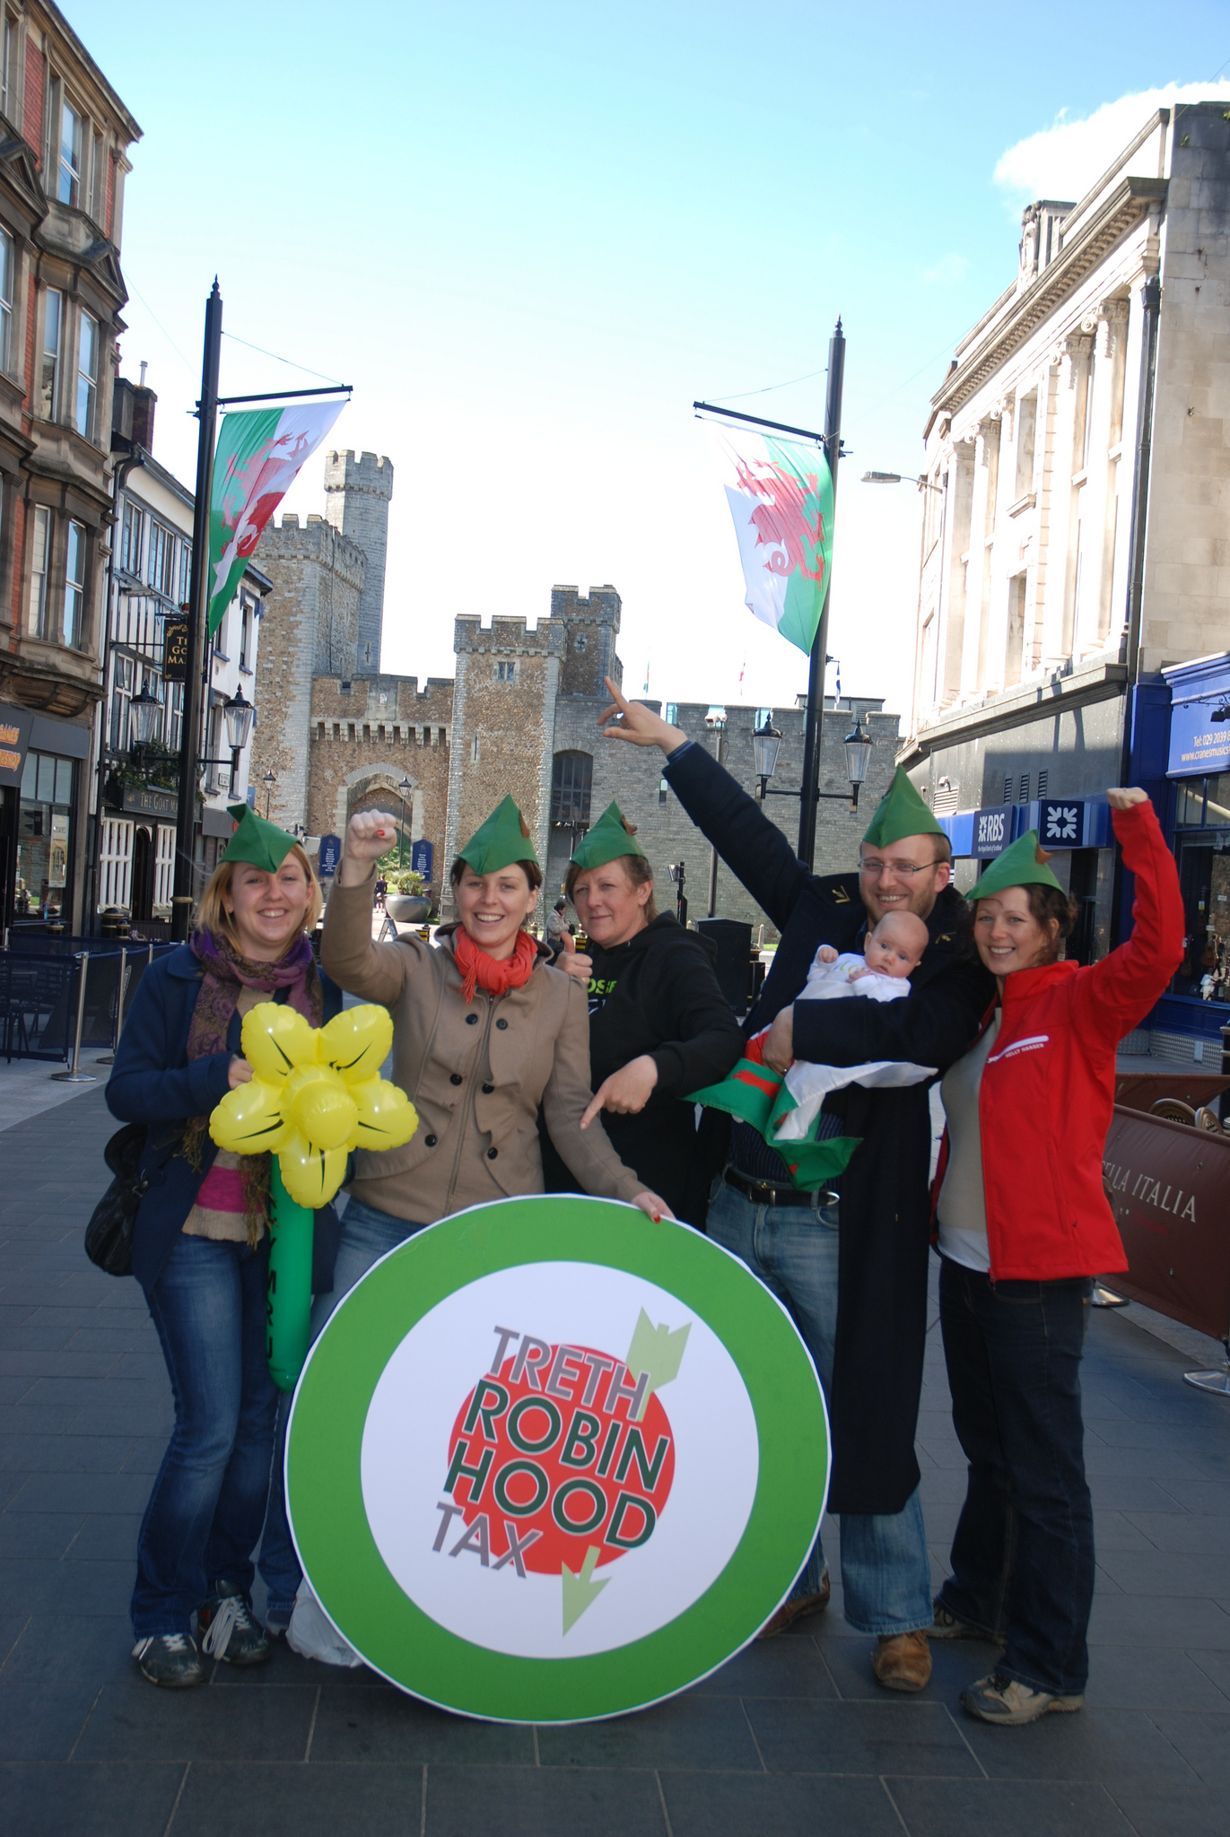
Bring Robin Home to Wales
We’re delighted to partner with UNISON Wales to help raise the profile of the Robin Hood Tax in Wales and to draw attention to the need for additional resources for public services.
Our campaign aim is to encourage Welsh councils to support a motion calling on the UK government to back an RHT.
So far, 8 councils have backed it across Wales (74 across the UK)
We’ve had media pieces in the Western Mail and other Welsh local/regional publications
Welsh Labour leader Mark Drakeford has endorsed the campaign!

Slide 5
And it’s needed!
You know better than most the toll from the fall-out of the last crisis and the austerity that continues to this day.
And the financial sector can afford it. In the years since the crisis started, the four big banks have made over £150bn in profits, and paid themselves tens of billions in bonuses.
Meanwhile public services have been cut to the bone.

Slide 6

Robin can do
a lot of good
The extra money from four months of a Robin Hood Tax could reverse all cuts to Welsh Government spending since the crisis
The extra money from two months of a Robin Hood Tax could reverse all local authority funding cuts in Wales
One month of a Robin Hood Tax could meet the extra funding needs for adult social care in Wales over the next 20 years

Slide 7
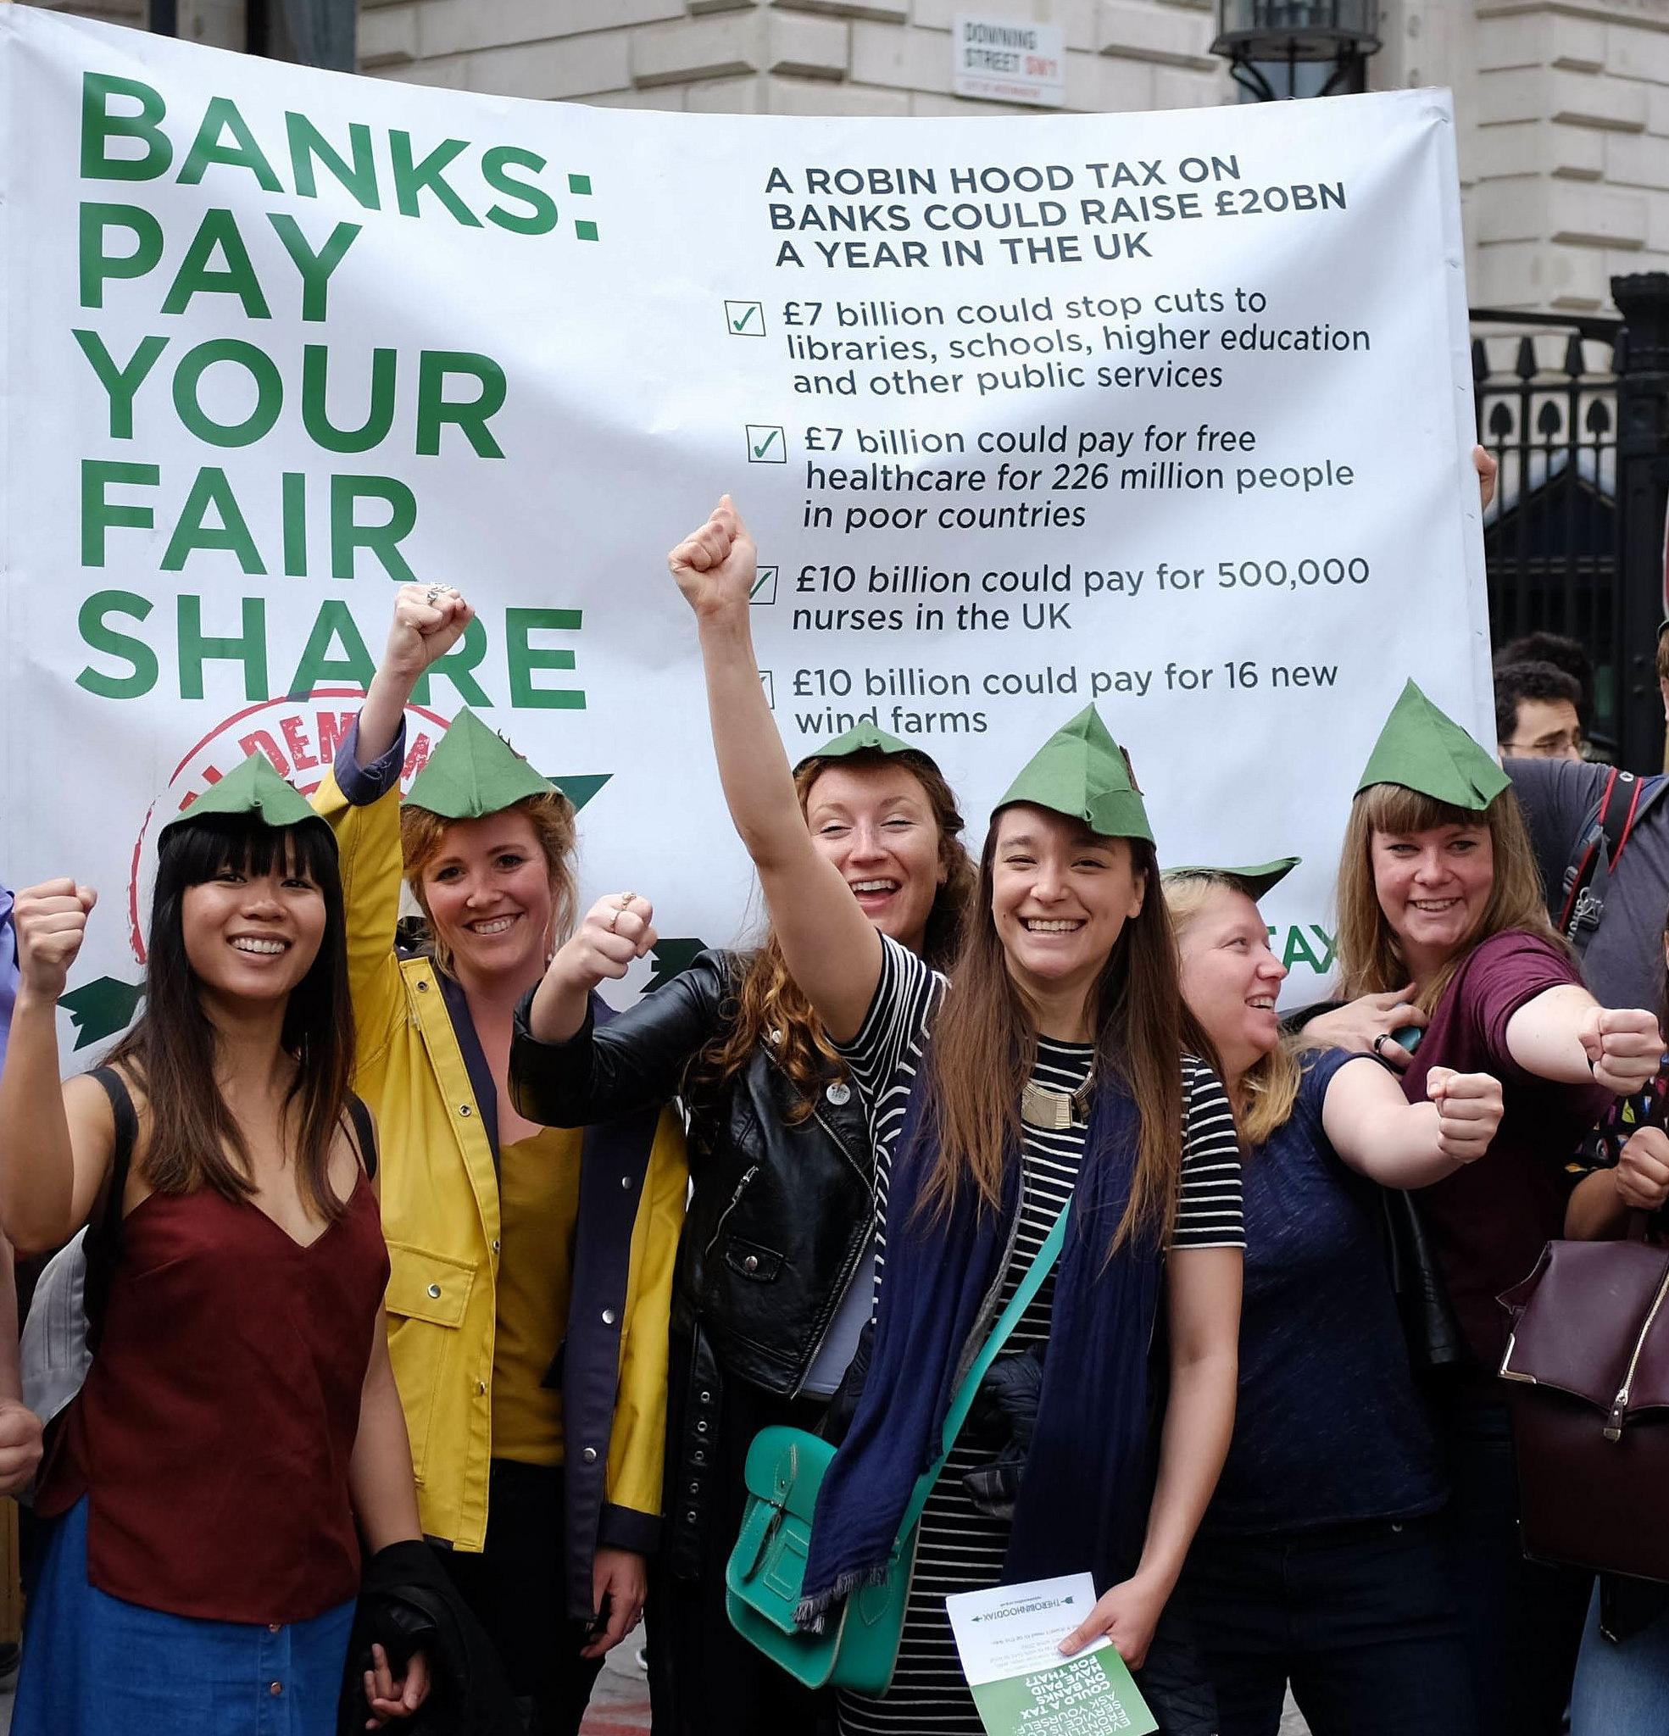
We’re just getting started...
...But we need your help!
There are still 14 councils across Wales who haven’t backed the Bring Robin Home campaign. And we need to fight back against cuts and show that there’s an alternative!
Would you be interested in backing Robin where you live? Will yours be the 75th council?!

Slide 8


robinhoodtax.org.uk/bringrobinhome
Tom Warren
tom@robinhoodtax.org.uk
0207 324 5052

